Slide 1
Clarity CFO
Grandview Ventures – Dan Balette

Slide 2
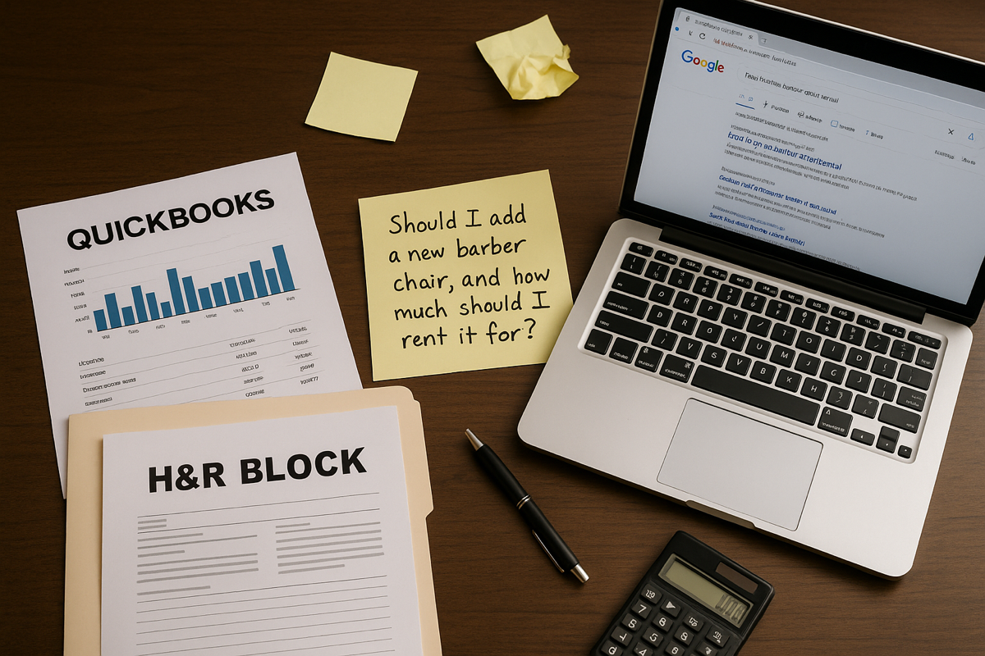
The Problem
Small businesses and nonprofits lack affordable, tailored financial guidance.
They’re overlooked by industry tools and forced to rely on:
QuickBooks / Square for raw data
H&R Block for tax & general accounting advice
Google for strategy
But questions like:
“Should I add a new barber chair, and how much should I rent it for?” “Where
should I place my limited staff for the biggest visitor impact?” are answered by
intuition, not data.
Notes:
What we’ve found is that small businesses and nonprofits; especially owner-operated ones, are consistently left out of the financial innovation conversation.
They don’t have access to affordable, tailored financial guidance. The tools that do exist like QuickBooks or Square are great at tracking transactions but fall short when it comes to strategic decision-making.
When tax season rolls around, many turn to H&R Block or similar services, which are reactive and compliance-focused not built for proactive planning.
And when it comes to big questions questions that affect day-to-day operations or long-term growth the default is… Google. Or gut instinct.
Imagine running a barbershop and wondering: Should I add another chair? How much should I rent it for? Or managing a nonprofit and asking: Where should I place my limited staff to have the biggest impact on visitors?
These are strategic, data-driven decisions but right now, they’re being answered by guesswork.
That’s the gap we’re addressing. These operators don’t need another tool. They need a trusted, affordable, intelligent guide that understands their context and gives answers that actually move the needle.

Slide 3

My Solution
Clarity CFO
An AI-powered financial assistant built for under-supported operators:
Personalized guidance that improves over time
Converts messy financial data into clear, actionable strategy
Designed for owner-operators, nonprofits, and service-based businesses
Notes:
So; here’s what I built: it’s called Clarity CFO.
It’s not just another dashboard or accounting tool it’s an actual assistant. One that’s smart enough to learn from your business over time, and actually help you make better decisions as it goes.
Most people in this space don’t have a financial analyst on staff. They don’t have time to clean their data or figure out how to pull insights from spreadsheets. That’s where this comes in.
You connect your financials QuickBooks, Square, CSVs, whatever and it gives you clear, strategic answers.
Not generic advice. Not canned suggestions. Real, tailored guidance based on your business, your context.
And it’s designed for folks like barbershop owners, nonprofit directors, people who are doing the work themselves, making tough calls every day, often without support.
This is about leveling the playing field and giving them a tool that feels like it’s actually on their team.

Slide 4
Why Now?
AI has matured and is affordable even for the smallest businesses
Bookkeeping tools are widespread, but strategic insight is missing
Post-COVID recovery has created a renewed focus on lean, high-impact operations
Demand for affordable, intelligent tools is growing
Notes:
Timing matters. And right now, the conditions are perfect for a tool like Clarity CFO.
First; AI has finally hit that point where it’s powerful, reliable, and affordable. You don’t need a million-dollar IT budget to use it. Even the smallest businesses can now access tech that used to be reserved for enterprise.
Second; almost every small business or nonprofit I talk to already has some kind of bookkeeping tool in place. QuickBooks, Wave, Square the data is there. But no one’s helping them make sense of it. They’re drowning in numbers, but starving for strategy.
Third; post-COVID, most small operators are running leaner than ever. That’s forced a mindset shift. They can’t afford waste they need every dollar, every staff hour to count. So tools that deliver high-impact guidance aren’t just nice to have they’re essential.
And finally; the demand is already here. These folks are Googling financial questions every day. They’re on Reddit, asking strangers how to price their services. They want something smarter, something trustworthy. They just haven’t had access until now.

Slide 5
Product Demo & Features
(Current prototype in development)
Features planned or in progress:
Upload and analyze QuickBooks/CSV data
Ask natural language questions (“Can I afford a second chair?”)
Auto-generate cash flow scenarios and pricing strategies
Learning loop: gets smarter with continued use
Visual dashboards + voice/chat interface
Notes:
The core prototype is in development and I’ve been building and refining it feature by feature.
The goal is to keep it simple for the user, but powerful under the hood.
You’ll be able to upload your QuickBooks file or a basic CSV whatever you’ve got. The system reads it, cleans it up, and gets to work.
Then, you can ask natural questions just like you would with a human CFO: “Can I afford to add another chair?” “What would happen to my cash flow if I hired part-time help?”
Behind the scenes, it’s running scenarios, analyzing revenue patterns, and giving you tailored answers not just surface-level charts.
It also learns over time. The more you use it, the more it understands how your business operates so the insights get sharper and more personalized.
On the front end, it’s visual and intuitive. Dashboards you can actually use. And I’m building in a voice/chat interface so it feels conversational like talking to someone who knows your business.
Bottom line: I’m not building a tool for finance people. I’m building a tool for real operators who need clarity, not complexity.

Slide 6
Market Opportunity
Target Segments:
650K+ small businesses in personal services (e.g., barbers, salons, yoga studios)
– Source: U.S. Census Bureau, Non-employer Statistics (2023)
1.5M+ nonprofits in the U.S., many with fewer than 10 employees
– Source: National Center for Charitable Statistics (NCCS)
– 75% have fewer than 10 employees (Urban Institute, 2023)
– 66% operate on budgets under $500K (Urban Institute, 2023)
Total Addressable Market (TAM):
~$2.5B annually in financial tools, bookkeeping software, and outsourced advisory services for under-10-person organizations
– Source: Veritas Analytics TAM estimate using IRS Form 990 data, QuickBooks & Wave SMB pricing models, and industry benchmarks
Initial Go-to-Market:
Sole Proprietors
Micro-nonprofits with under $1M in annual budget
– Focus: operational efficiency, grant readiness, and strategic staffing
Notes:
The folks I’m building for? They’re everywhere and there’s a lot of them.
We’re talking about 650,000+ small service-based businesses. Barbershops, salons, yoga studios solo operators and teams of 2 or 3 people, max.
Then you’ve got nonprofits over 1.5 million in the U.S. And the vast majority of them? They’ve got fewer than 10 employees and they’re running on shoestring budgets two-thirds are under $500K a year.
These aren’t just statistics these are the people doing mission-driven work, or running businesses in their communities, without access to good financial tools.
When you add it all up, this creates a ~$2.5 billion opportunity. That includes what they’re already spending on bookkeeping software, spreadsheets, outsourced accountants or just burning time trying to figure it out themselves.
My go-to-market is focused and intentional. I’m starting with sole proprietors and micro-nonprofits folks with real pain, clear need, and the least access to quality insight.
We’re not trying to replace their accountant we’re giving them something they’ve never had: an affordable, intelligent financial copilot that actually understands their world.

Slide 7
Business Model
Freemium + Subscription Tier
Free: Basic dashboard and limited Q&A
$19/month: Pro features, insights, predictions
$49/month: Premium tier with scenario planning + team collaboration
Potential affiliate revenue from linked services (insurance, payroll, etc.)
Notes:
I’m keeping the business model simple and aligned with how small operators actually think about spending money.
It starts with a freemium tier a no-risk way for people to try it out. They get a basic dashboard and can ask a limited number of questions. Just enough to get a taste and see the value.
Then there’s a $19/month Pro tier that’s where you unlock more in-depth insights, trend analysis, and financial predictions.
For folks who need to model scenarios, or collaborate with a board or team there’s a $49/month Premium tier. That includes scenario planning and shared workspace functionality, which is really helpful for nonprofits or multi-owner businesses.
Long term, there’s also an opportunity to generate affiliate revenue through linked services like insurance, payroll, or grant writing things these users are already paying for elsewhere.
The key is keeping the price points accessible and the value obvious because these are users who don’t have time to mess around, and every dollar counts.

Slide 8

Traction
Codebase under active development
Core features mapped and partially built
Summer 2025: Full-time focus on development
Early interest from nonprofit and barbershop communities
Notes:
I’ve been bootstrapping the development so far the codebase is active and evolving week by week.
The core features are already mapped out and partially built I’m not starting from scratch. This summer, I’m going full-time on Clarity CFO, which means I’ll have the time and focus to bring the MVP to life.
And it’s not just theoretical I’ve already had early interest from the exact people I’m building for.
A few nonprofits have reached out saying, “Let me know when it’s ready, we’ll test it.” And barbershop owners I’ve spoken with instantly get the value.
The pain is real, and people are already raising their hands.

Slide 9




Team & Why Me
Founder: Dan Balette
A builder with a bias toward action and a track record of solving real problems.
Grounded in both mission and execution – I’ve been on the front lines of nonprofits as a staff member, board leader, and volunteer. I know the operational struggles because I’ve lived them.
Fluent in finance and AI – I bring a unique combination of analytical depth & technical skill, with experience in accounting, data science, and AI-powered product development.
Driven by empathy– My focus is on serving people who are too often overlooked by traditional tools; small operators who deserve clarity and control, not complexity and confusion.
Proven resilience and vision – From military service to graduate school, I’ve consistently taken the hard road when it mattered and I’ve built this product with intention, momentum, and a long-term view.

Slide 10
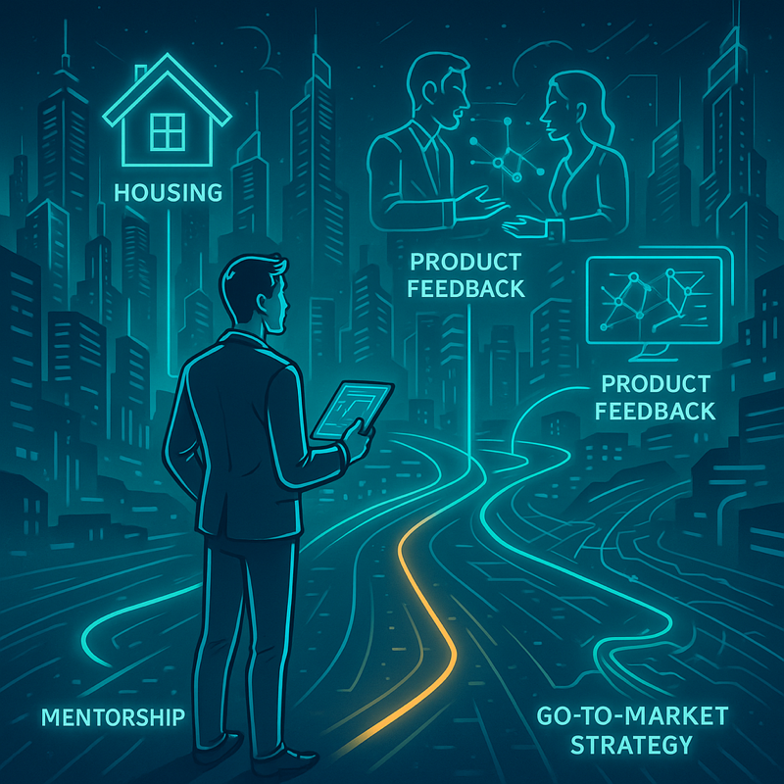
My Ask:
Looking for:
Summer housing
Mentorship and access to innovation community
Product feedback and pilot users
Help refining go-to-market strategy

